Slide 1

High Quality Code
Course Introduction
SoftUni Team
Technical Trainers
Software University
https://softuni.bg/

Slide 2
Table of Contents
Course Objectives
Training and Team
Course Organization
Course Infrastructure
Evaluation Criteria
2

Slide 3
Have a Question?
sli.do
#HQC

Slide 4

Course Objectives

Slide 5
High Quality Code Course Goals
Introduction to High Quality Code
Design Patterns
Creational
Structural
Behavioral
Refactoring
5

Slide 6
Exams
Practical Programming Exam
1 problems for 4 hours
Refactoring and bug fixing
Implementing design patterns
Theoretical Exam
Automated quiz system
You will have 20 minutes once you enter
English
10 Questions
6

Slide 7

The Team

Slide 8
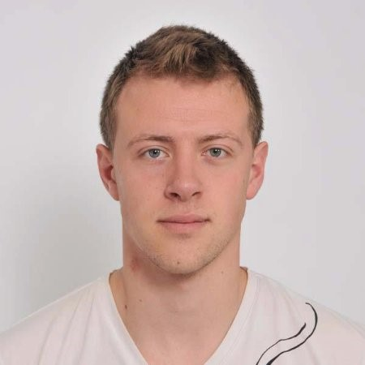
Boncho Valkov
Software Engineer @ SessionStack
6+ years in the IT
Most of his experience is related with .NET
Currently works with Python and Node.Js
Interested in Service Oriented Architectures (SOA)
He likes to try new technologies

Slide 9

Course Organization

Slide 10
Course Timeline
13-December-2019
25-January-2020
High Quality Code
3 weeks * 2 times / week
9 credits
Start: 13-December-2019
Theoretical Exam: 25-January-2020
Practical Exam: 25-January-2020
Theoretical Exam Retake: 1-February-2020
Practical Exam Retake 1-February-2020

Slide 11


Scoring System for the Course
Theoretical Exam 10%
PracticalExam 90%
Evaluation
11

Slide 12



Course Web Site, Forum and FB Group
Official web site:
Official Facebook group:
Community Facebook group:
https://softuni.bg/trainings/hqc-december
https://www.facebook.com/groups/CSharpMasterclassOctober2019/
https://www.fb.com/groups/HighQualityCode

Slide 13
Questions?
Notes:
13

Slide 14












SoftUni Diamond Partners

Slide 15




SoftUni Organizational Partners

Slide 16
Trainings @ Software University (SoftUni)
Software University – High-Quality Education, Profession and Job for Software Developers
softuni.bg, softuni.org
Software University Foundation
softuni.foundation
Software University @ Facebook
facebook.com/SoftwareUniversity
Software University Forums
forum.softuni.bg
16
Notes:
16

Slide 17

License
This course (slides, examples, demos, exercises, homework, documents, videos and other assets) is copyrighted content
Unauthorized copy, reproduction or use is illegal
© SoftUni – https://softuni.org
© Software University – https://softuni.bg
Notes:
17

